Slide 1
A Taste of Fisheries Science
Dr. David Keith and Dr. Heather Bowlby
Fisheries and Oceans, Canada

Slide 2
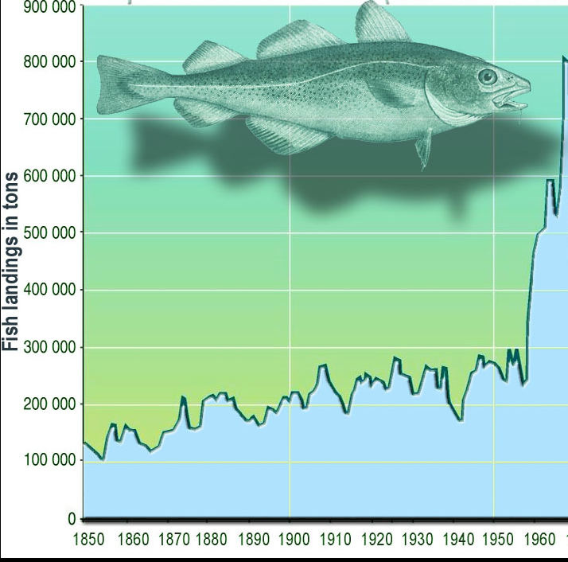
Do Catches Tell Us About a Population?
Catch is proportional to abundance under Baranov’s catch equation
Factors affecting the amount of fish caught
Number of vessels
Characteristics of vessels
Spatial distribution of fishery relative to stock
Selectivity and Gear
Abundance
Notes:
Blue box identifies in-person topics. Others are done outside of the module time.

Slide 3
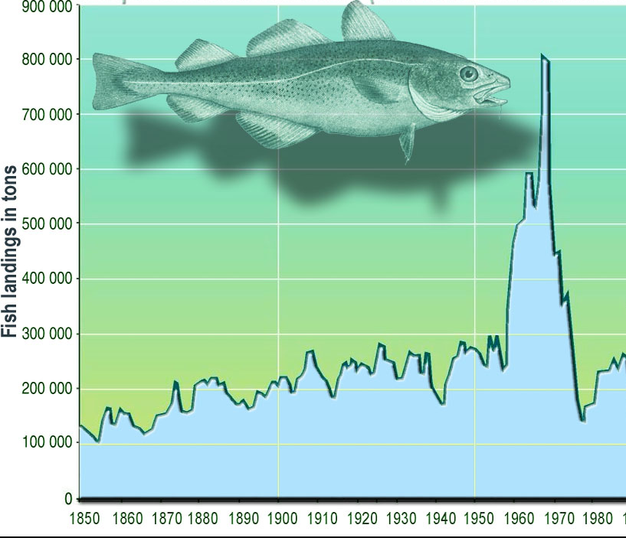
What is Management Supposed to Do?
When catches are declining, management is supposed to be more restrictive
Changes implemented in 1976
Intention of management is to promote population increase
Catches started climbing
Levels similar to ~1950s
Success??
Notes:
Blue box identifies in-person topics. Others are done outside of the module time.

Slide 4
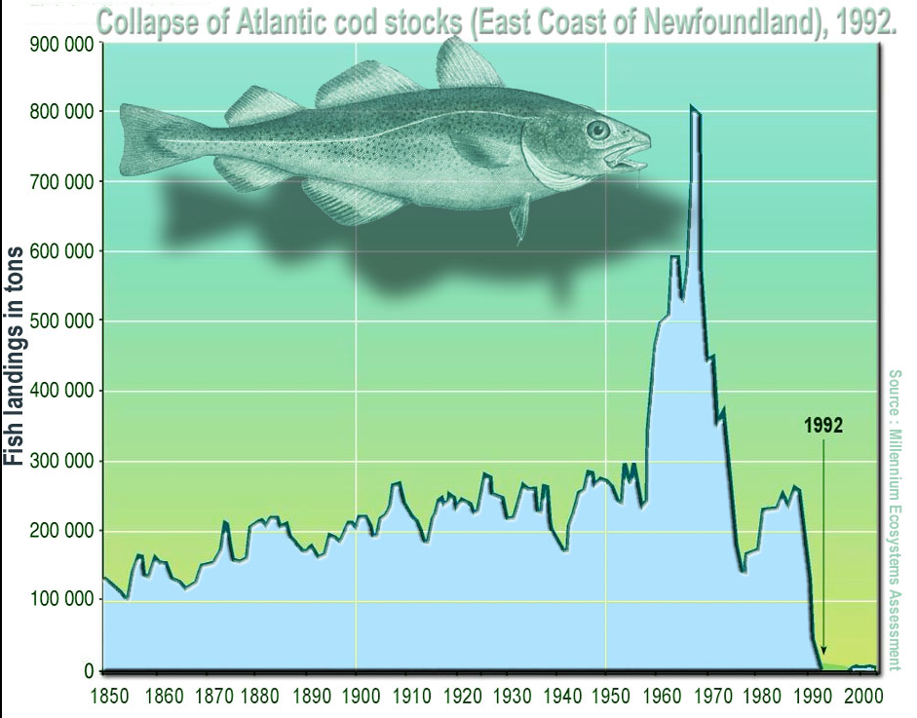
Everyone Knows How This Story Ends
Obvious that landings do not tell the correct story about the state of the stock
1949 Newfoundland joined Canada
1960s Factory trawlers entered fishery
1969 Canada claimed 200 nm EEZ under UNCLOS
1976 Canada declared right to manage within 200 mn EEZ
1986 Stock assessment: recommended TAC be cut in half
limited knowledge of cod biology
no change in management

Slide 5
Hindsight Truly is 20:20
Managers can only use the information that they have available
Cod example:
Canadian research survey was in its infancy (short timeseries)
Limited biological knowledge (lifespan, population structure)
Scientific basis for decision-making was overly optimistic (retrospective patterns)
Foreign vessels left Canadian waters resulting in an apparent increase CPUE;
Historical inertia and socioeconomic considerations
Unwillingness to take drastic/unpopular [and unprecedented] steps

Slide 6
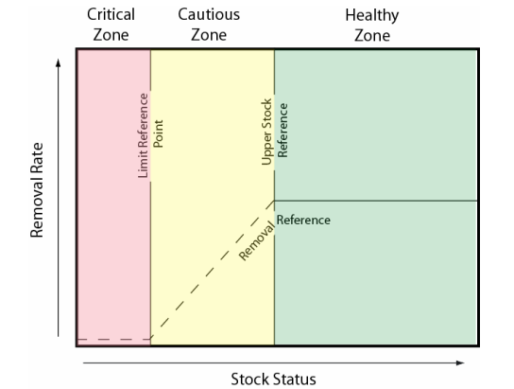
Precautionary Approach
Being cautious when scientific knowledge is uncertain, and not using the absence of adequate scientific information as a reason to postpone action or failure to take action to avoid serious harm to fish stocks of their ecosystem.
Biomass
F

Slide 7
Key Ideas Under PA Framework
LRP: stock level below which productivity is sufficiently impaired to cause series harm but above the level where the risk of extinction becomes a concern; Critical Zone
USR: threshold below which the removal rate is reduced; above is the Healthy Zone
Between LRP and USR: Cautious Zone
Removal Reference: maximum acceptable removal rate; ratio of all human-induced removals to total exploitable stock size
Management: Cautious Zone = actions taken to promote stock rebuilding. Cannot exceed RR
Management: Critical Zone = actions must promote stock growth; Removals kept to lowest possible level

Slide 8
Reference Points
An exceptionally brief introduction to the most under-appreciated component of stock assessment
Notes:
Discussion with the group.

Slide 9
Types of Overfishing
Growth Overfishing: too many fish are caught while they are very small and haven’t had a chance to reproduce
Fish are harvested at a size that is smaller than the size that would maximize yield
Recruitment Overfishing: exploitation reduces spawning biomass to the point where recruitment is significantly impaired.
The population is too small to maintain high reproductive rates.
Both types of overfishing pre-suppose that reference points are biologically-based (i.e. appropriate for the life history of the animal)

Slide 10
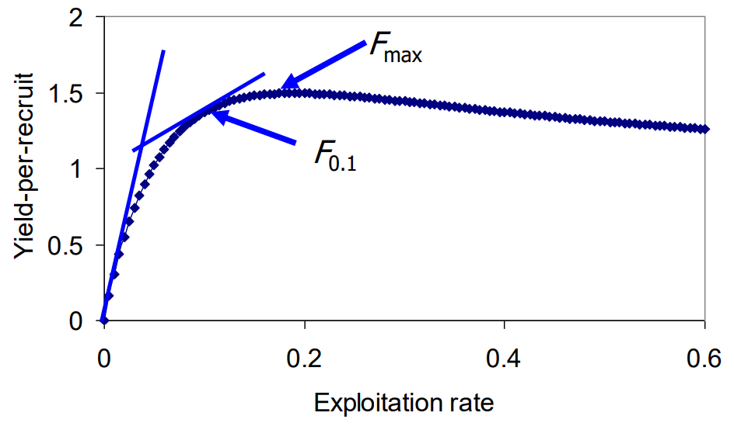
Yield-Per-Recruit (F-based Reference Points)
Density-independent model where recruitment is assumed constant
Exploiting the stock at the age/size when the cohort’s biomass reaches a maximum
Depends on:
Natural mortality
Growth rate
Age at first capture or selectivity

Slide 11
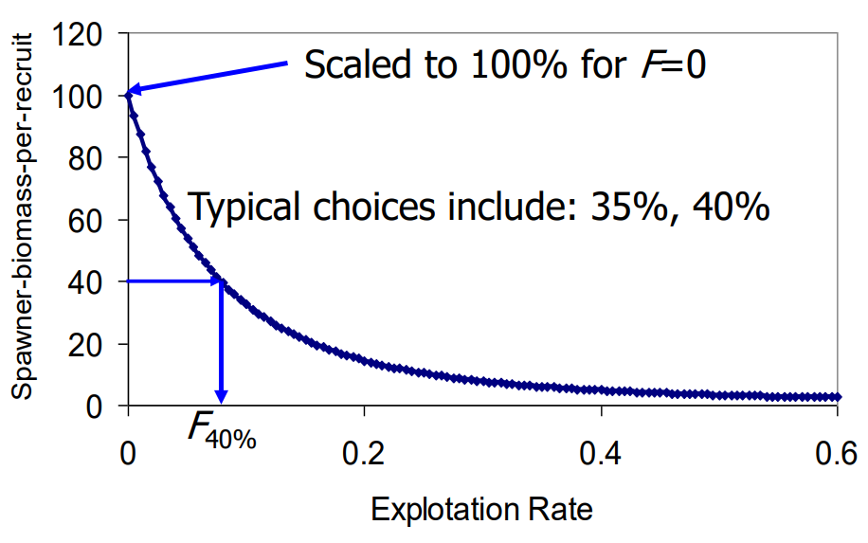
Spawner-Biomass-Per-Recruit (% SPR Reference Points)
Fishing mortality rate that reduces unfished spawner biomass per recruit to a given percentage
Exploiting the stock at a specific percentage of recruits that survive to spawn.
Depends on:
Gear selectivity
Growth
Fecunity at age
Natural mortality

Slide 12
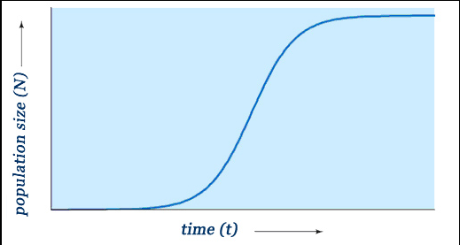
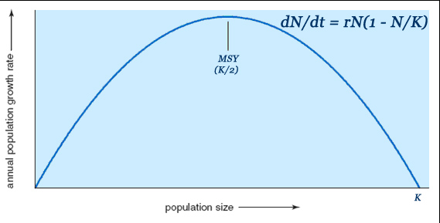
Maximum Sustainable Yield (Fmsy and Bmsy Reference Points)
The maximum level at which a natural resource can be routinely exploited without long-term depletion
The size of a natural population at which it produces a maximum rate of increase, typically at half of carrying capacity

Slide 13
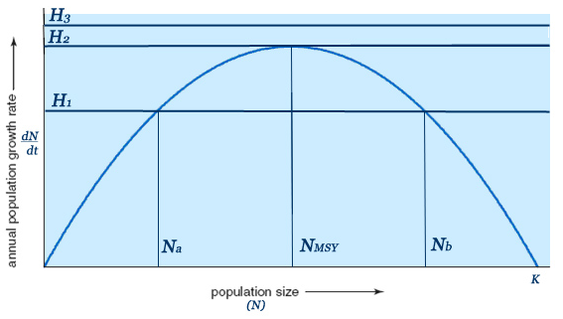
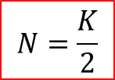

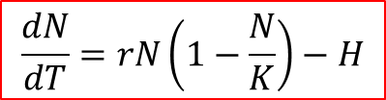
Setting Harvest Levels at MSY
Consider a population with no age structure
Equilibrium
Harvesting at H2 = Nmsy; population size that produces the maximum growth rate
Functional Form depends on Assumed Model for stock assessment
Schaefer
$$\frac{dN}{dT}=rN\left(1−\frac{N}{K}\right)−H$$
$$rN\left(1−\frac{N}{K}\right)=H$$
$$N=\frac{K}{2}$$
Notes:
H1 = 2 equilibrium points. If population is at Nb, harvesting at H1 is a stable strategy. If the population is reduced, its growth rate will increase to push it back towards Nb. HOWEVER, this is not true at Na because any decrease in the population will tend to decrease the population further (as r is reduced).

Slide 14
YPR and SPR vs. MSY
YPR and SPR do not incorporate compensatory dynamics
Typically, they do not account for recruitment variability
Do not intrinsically protect biomass and reproductive potential
MSY relies on compensatory dynamics (density dependence)
At smaller stock sizes, the rate at which spawners produce recruits will be higher than at large stock sizes
Ideally requires the ability to estimate carrying capacity (virgin biomass) and steepness/slope at the origin of an S-R curve

Slide 15
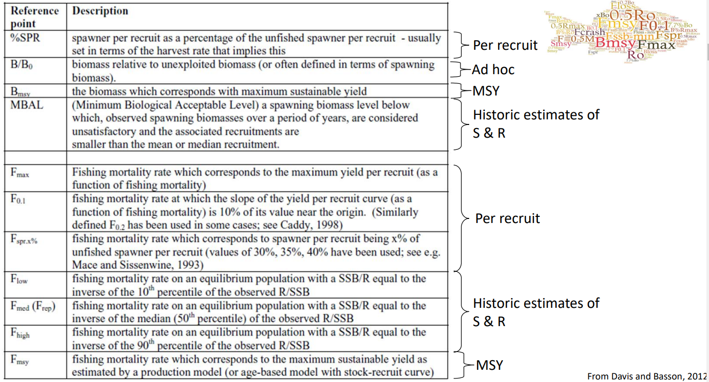

Slide 16
Assessment Relative to Reference Points
An exceptionally brief introduction
Notes:
Discussion with the group.

Slide 17
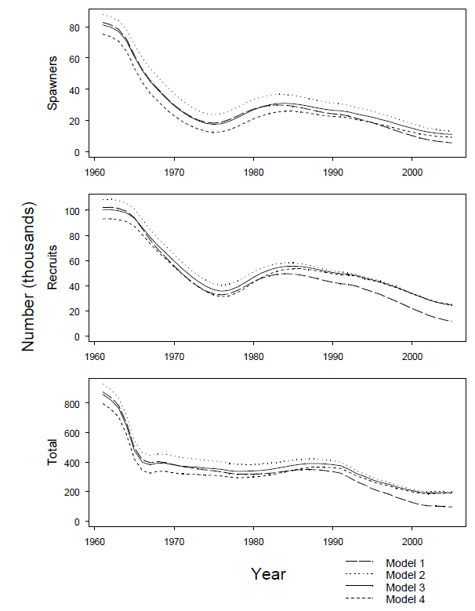
Interpreting Stock Assessments Relative to Reference Points: 1
Various models are typically used to explain the observed data
Example from Porbeagle Shark
Evaluate parameters, residuals, overall fit, residual deviance/AIC etc.
Note that the model predictions typically lag by one year.
Assessment in 2020 using data until 2019; but deriving advice for 2021.

Slide 18
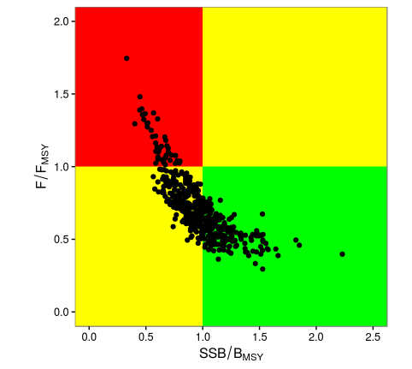
Interpreting Stock Assessments Relative to Reference Points: 2
Evaluate the ‘terminal year’ predictions for F and SSB
How close/far are we from the reference point?
Example is relative to MSY
From multiple models, this is done probabilistically:
Showing individual predictions of the stock and harvest
This gives Status right now.
Probability overfished (F too high)
Probability of overfishing (B too low)

Slide 19
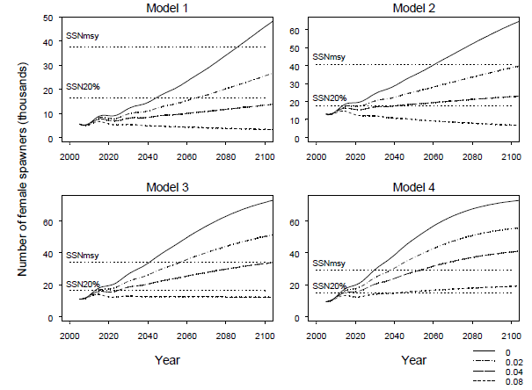
Interpreting Stock Assessments Relative to Reference Points: 3
How do we set limits for the future?
Make an assumption about removals in the current year (i.e. 2020)
Project the population forward on the basis of its biology
Assuming different levels for F
Determine how the predictions behave relative to reference points

Slide 20
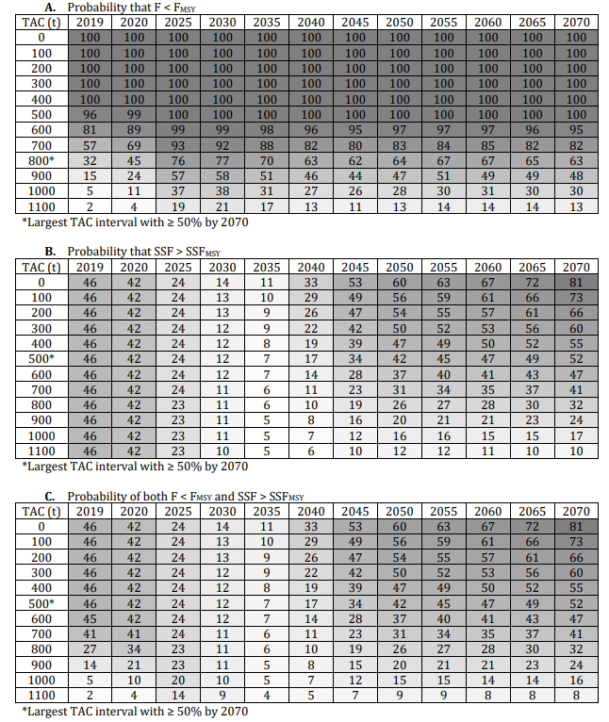
Produce Probabilistic Catch Advice
If we set TAC at level X, what is the likelihood that we would maintain the stock at an appropriate level?
Example is from Shortfin Mako in the North Atlantic
Managed relative to MSY (Fmsy and a proxy for Bmsy called SSFmsy)
Interesting characteristics:
Growth overfishing shown SSF table
Extremely long timelines for ‘recovery’ to MSY due to life history characteristics

Slide 21
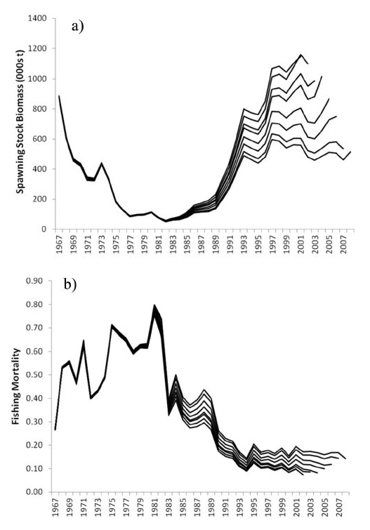
A Final Comment: Retrospective Patterns
Very powerful diagnostic tool
Shows systematic bias in the estimate of biomass and fishing mortality
Compare model fits as the terminal year of data is ‘peeled’ (i.e. remove 2019, then 2018, then….)
Generally arise from:
Time-varying processes are unaccounted for
Data are contradictory or incomplete

Slide 22


Dusky Scallop Shark
Determine life history; sample some data; develop a model; account for F from removals; determine status; project future status relative to future potential catch.

